Slide 1
MULTIMEDIA PRODUCTION | WEEK 2
MULTIMEDIA
LEARNING THEORIES
Lectures 3 & 4 | Theories of Multimedia Learning
Cognitive Theory of Multimedia | Dual Coding Theory

Slide 2
LEARNING JOURNEY
01
Introduction to Multimedia Learning
Contents
Understanding the foundations of how we learn from words and pictures combined
An exploration of the foundational theories that guide effective multimedia design for learning.
02
Cognitive Theory of Multimedia Learning
Richard Mayer's 12 evidence-based principles for multimedia instructional design
03
Dual Coding Theory
Allan Paivio's theory of verbal and visual information processing systems

Slide 3

01
Introduction to Multimedia Learning
Understanding the foundations of how we learn from words and pictures

Slide 4

MULTIMEDIA PRODUCTION | W2
What is Multimedia Learning?
Definition
Learning through a combination of words (spoken or printed text) and images (illustrations, charts, photos, animations, video).
The Multimedia Principle
People learn more effectively from words and graphics than from words alone.
Common Examples
PowerPoint presentations with visuals
Recorded lectures with on-screen graphics
Concept maps and mind maps
Illustrated textbooks and manuals
Source: Mayer, R. E. (2009). Multimedia Learning. Cambridge University Press.
04

Slide 5
MULTIMEDIA PRODUCTION | W2
Why Multimedia Learning Matters
Boosts Engagement
Enhances Retention
Diverse Learning Styles
Interactive and visually stimulating content captures attention more effectively than text-only materials, encouraging sustained interest.
Presenting information through multiple formats allows learners to process and remember complex topics from different angles.
Offering content in various forms makes education more adaptable, inclusive, and accessible to all learners.
70%
of students prefer digital learning to traditional classrooms when multimedia is well-designed and effectively implemented.
Source: Digital Learning Institute Survey, 2023
05

Slide 6
MULTIMEDIA PRODUCTION | W2
The Science Behind Multimedia Learning
Three foundational assumptions from cognitive science underpin all multimedia learning theories:
01
02
03
Dual-Channel Processing
Limited Capacity
Active Processing
Humans have separate channels for visual/pictorial and auditory/verbal information processing.
Each channel can only process a limited amount of information at one time, requiring careful content design.
Meaningful learning requires learners to actively select, organize, and integrate information.
These three assumptions form the basis of both the Cognitive Theory of Multimedia Learning (Mayer) and Dual Coding Theory (Paivio).
Source: Multimedia Learning Principles, UC San Diego
06

Slide 7
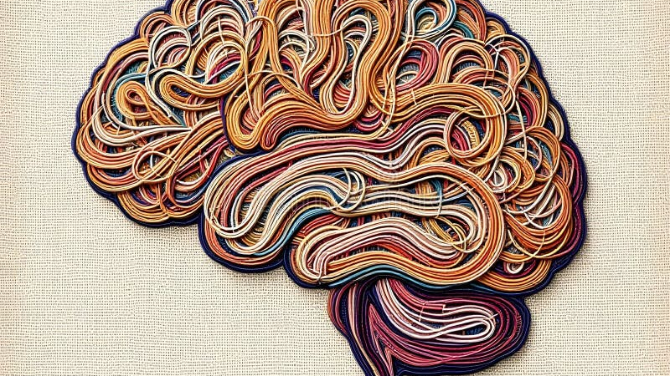
02
Cognitive Theory of Multimedia Learning
Richard Mayer's evidence-based framework for multimedia instruction

Slide 8
MULTIMEDIA PRODUCTION | W2
CTML Overview - Richard E. Mayer
THE THEORY
12
The Cognitive Theory of Multimedia Learning (CTML) draws together Dual Coding Theory and Cognitive Load Theory, applying them to multimedia instruction.
At its core: people learn more effectively from words and graphics than from words alone.
Evidence-Based Principles for Multimedia Instructional Design
KEY PUBLICATIONS
ABOUT THE AUTHOR
Multimedia Learning (2001, 2009, 2014)
The Cambridge Handbook of Multimedia Learning
200+ Experimental Research Studies
Professor, UC Santa Barbara (since 1975)
Richard E. Mayer - Professor of Psychology at UC Santa Barbara. Developed 12 evidence-based principles from 200+ experimental studies.
Source: Harvard Center for Health Decision Science, 2023
08

Slide 9
MULTIMEDIA PRODUCTION | W2
Three Core Assumptions of CTML
1
Dual-Channel Assumption
Humans possess separate information processing systems for visual/pictorial material and auditory/verbal material. On-screen text enters through the eyes but is converted to sounds for verbal processing.
2
Limited Capacity Assumption
Humans are limited in the amount of material they can process in each channel at one time. Presenting too much on screen overloads the visual channel; too much audio overloads the verbal channel.
3
Active Processing Assumption
Humans engage in meaningful learning by attending to relevant information, organizing it into coherent mental representations, and integrating with prior knowledge from long-term memory.
09

Slide 10
MULTIMEDIA PRODUCTION | W2
The Dual-Channel Assumption
Visual / Pictorial Channel
Auditory / Verbal Channel
Processes images, diagrams, animations, and video that enter through the eyes.
On-screen text is initially processed here before conversion to verbal processing.
Processes spoken words and sounds that enter through the ears.
Narration and spoken explanations are processed directly in this channel.
Key Implication
Presenting information through both channels simultaneously can enhance learning when properly designed, as each channel processes different types of information in parallel. This is the foundation of the Multimedia Principle.
Source: Mayer, R. E. (2001). Multimedia Learning. Cambridge University Press.
10

Slide 11
MULTIMEDIA PRODUCTION | W2
The Limited Capacity Assumption
Each information processing channel has constraints on how much it can process at once. Working memory can hold approximately 7 +/- 2 chunks of information.
When either channel is overloaded, learning suffers because the brain cannot effectively process and integrate new information.
7+/-2
Chunks of information that working memory can hold simultaneously in each channel
Visual Overload
Verbal Overload
Too much material on screen at once overloads the visual/pictorial channel, causing learners to miss key information.
Too much auditory information at once overloads the auditory/verbal channel, reducing comprehension.
11

Slide 12
MULTIMEDIA PRODUCTION | W2
The Active Processing Assumption
Meaningful learning requires active cognitive engagement through three essential processes:
1
2
3
Selecting
Organizing
Integrating
The learner must identify and select relevant words and images from the presented material, filtering out irrelevant information.
The learner must organize selected information into coherent mental representations, creating a verbal model and a pictorial model.
The learner must connect mental representations with each other and with prior knowledge from long-term memory.
All five processes (selecting words, selecting images, organizing words, organizing images, and integrating) must occur for meaningful learning to take place.
12

Slide 13
MULTIMEDIA PRODUCTION | W2
The Five Cognitive Processes in CTML
1
2
3
4
Selecting Words
Selecting Images
Organizing Words
Organizing Images
Attend to relevant verbal info
Attend to relevant visual info
Build verbal mental model
Build pictorial mental model
5
Integrating
Connect models with prior knowledge
Process Details
Selecting involves paying attention to relevant incoming words and images. Organizing involves building coherent mental structures from the selected material. Integrating involves connecting the verbal and pictorial models with each other and with prior knowledge.
Multimedia design should facilitate each of these five processes to maximize learning effectiveness. When any process is hindered, learning outcomes decrease.
13

Slide 14
MULTIMEDIA PRODUCTION | W2
Reducing Extraneous Processing - Part 1
GOAL: ELIMINATE UNNECESSARY COGNITIVE LOAD
Coherence Principle
Signaling Principle
Redundancy Principle
"People learn more deeply when extraneous material is excluded."
Eliminate distracting graphics, sounds, and unnecessary content that doesn't support learning goals.
"People learn more deeply when cues highlight essential material."
Use outlines, headings, and highlighting to guide attention to what's important.
"People learn better from graphics + narration than from graphics + narration + on-screen text."
Avoid duplicating spoken words as on-screen text.
Source: Mayer, R. E. (2009). Multimedia Learning Principles.
14

Slide 15
MULTIMEDIA PRODUCTION | W2
Reducing Extraneous Processing - Part 2
Spatial Contiguity Principle
Temporal Contiguity Principle
"People learn more deeply when corresponding words and pictures are presented near each other." Place text labels close to relevant parts of diagrams.
"People learn more deeply when words and pictures are presented simultaneously." Present narration at the same time as corresponding animation.
The Image Principle
"People do not necessarily learn more deeply when the speaker's image is visible on screen." The teacher's face isn't always integral to learning the material and adds cognitive load that must be weighed against affective benefits.
Source: Mayer, R. E. (2009). Multimedia Learning Principles.
15

Slide 16
MULTIMEDIA PRODUCTION | W2
Managing Essential Processing
GOAL: MANAGE THE COGNITIVE LOAD OF ESSENTIAL MATERIAL
Segmenting Principle
Pre-training Principle
Modality Principle
"People learn more deeply when content is presented in learner-paced segments."
Break lessons into manageable chunks that learners control, defined by content complexity and learner level.
"People learn more deeply when they know names and characteristics of main concepts first."
Provide definitions and key characteristics before the main lesson to free up cognitive capacity.
"People learn more deeply when words are spoken rather than printed."
Use narration with visuals so the visual channel processes images while the verbal channel processes spoken words.
Source: Harvard Center for Health Decision Science, 2023
16

Slide 17
MULTIMEDIA PRODUCTION | W2
Fostering Generative Processing
GOAL: USE SOCIAL CUES TO MOTIVATE DEEPER COGNITIVE ENGAGEMENT
Personalization Principle
Voice Principle
Embodiment Principle
"People learn better when words are in conversational style rather than formal style."
Use "you" and "your" to create social presence and social proximity between educator and learner.
"People learn better when narration uses a friendly human voice rather than machine voice."
Human voices create social proximity and enhance learner motivation.
"People learn better when onscreen agents use human-like gestures and movements."
Pedagogical agents with natural movements enhance learning through social cues.
Source: Mayer, R. E. (2009). Multimedia Learning Principles.
17

Slide 18
MULTIMEDIA PRODUCTION | W2
Mayer's 12 Principles at a Glance
Category | Principles
Reduce Extraneous Processing | Coherence, Signaling, Redundancy, Spatial Contiguity, Temporal Contiguity
Manage Essential Processing | Segmenting, Pre-training, Modality
Foster Generative Processing | Personalization, Voice, Embodiment
Foundation | Multimedia Principle: "People learn better from words and pictures than from words alone"
Image Note | Image Principle: Speaker's visible image doesn't necessarily improve learning outcomes
Total | 12 Evidence-Based Principles grounded in 200+ experimental research studies
Source: Mayer, R. E. (2009). Multimedia Learning. Cambridge University Press.
18

Slide 19
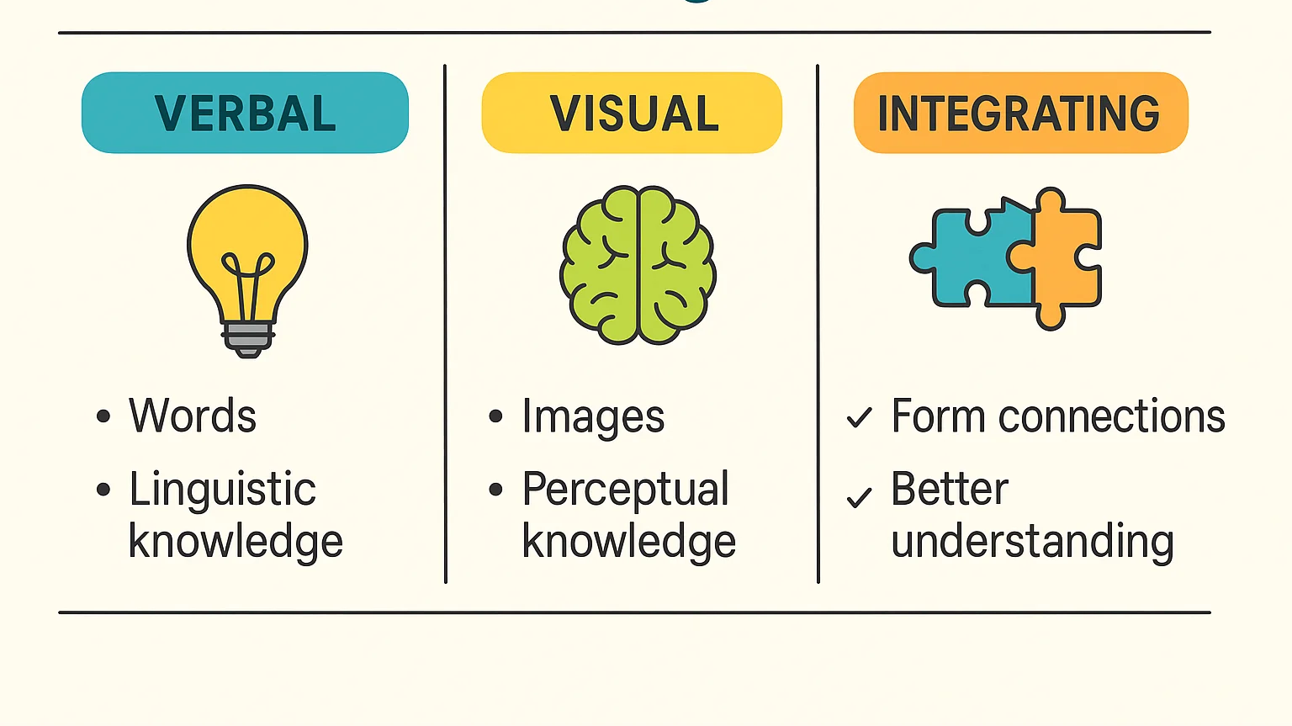
03
Dual Coding Theory
Allan Paivio's theory of verbal and visual information processing

Slide 20
MULTIMEDIA PRODUCTION | W2
Dual Coding Theory Overview - Allan Paivio
THE THEORY
ABOUT THE AUTHOR
Developed by Allan Paivio in 1971, Dual Coding Theory proposes that the human brain processes knowledge more effectively when multiple sensory modalities are simultaneously engaged.
The theory recognizes two separate but interconnected processing systems - one for verbal (language-based) information and one for non-verbal (image-based) information.
Unlike other theories, DCT emphasizes that these systems work independently but also form powerful connections that enhance memory and learning.
Allan Paivio - Canadian psychologist who revolutionized our understanding of how verbal and visual information interact in memory.
1971
Year Dual Coding Theory was first published, establishing a new framework for understanding multimodal cognition
Core Insight: When teachers use both verbal and visual elements, students create more complex interconnected memories, leading to better retention and understanding.
Source: NTU Academic Development Blog, 2025
20

Slide 21
MULTIMEDIA PRODUCTION | W2
Two Cognitive Processing Systems
The Verbal System
The Non-Verbal System
Responsible for processing language - both spoken and written words.
Creates logogens (verbal mental representations) when processing linguistic information.
Handles words, sentences, and linguistic concepts.
Deals with image-based information - visuals, sounds, sensations, and emotions.
Creates imagens (non-verbal mental representations) when processing visual and sensory information.
Handles images, sounds, and sensory experiences.
Key Characteristic
These two systems operate independently but can also interact, which is the key to enhanced learning and memory through dual coding.
Source: Paivio, A. (1971, 2007). Dual Coding Theory.
21

Slide 22
MULTIMEDIA PRODUCTION | W2
Representational Connections
Representational connections are formed within each processing system independently:
VERBAL SYSTEM
NON-VERBAL SYSTEM
Logogens
Imagens
When the brain receives a verbal stimulus (hearing or reading a word), it forms a cognitive structure in the verbal system called a logogen.
These connections are activated when we encounter the same or similar words again.
When the brain receives a non-verbal stimulus (seeing an image), it forms a cognitive structure in the non-verbal system called an imagen.
These connections are activated when we see similar visual stimuli again.
Example
When you see a cello, your mind constructs a mental image (imagen). When you see another string instrument, you use this pre-existing mental image to differentiate it from a cello.
Source: Paivio, A. (2007). Mind and Its Evolution.
22

Slide 23
MULTIMEDIA PRODUCTION | W2
Referential Connections
Referential connections are the links between the verbal and non-verbal systems:
When the brain responds to stimuli, it creates connections between verbal and non-verbal representations.
For example, when you hear the word "cello," you can associate it with the shape of the instrument, the sound it makes, and your emotional response to its music.
More Connections = Better Memory
The more referential connections the brain creates, the better we can remember and recall information.
Additional Benefit
Existing referential connections make it easier to interpret new stimuli and develop further connections that associate new information with cognitive structures already created.
Source: Paivio, A. (2007). Mind and Its Evolution.
23

Slide 24
MULTIMEDIA PRODUCTION | W2
Educational Applications of Dual Coding
Dual Coding Theory has significant implications for teaching and learning:
Visual Supplements
Active Creation
Discussion Around Visuals
Use whiteboards, charts, and concept maps to supplement verbal explanations
Draw diagrams, write keywords, display images that visually represent content
Involve students in verbal discussions around visual resources and materials
Hands-on Manipulation
Online Learning Design
Ask students to perform tasks involving manipulation of objects while receiving verbal instruction
In online contexts, Dual Coding requires careful planning to integrate visual and verbal content effectively
Unlike face-to-face learning where Dual Coding occurs naturally, online learning requires careful design to effectively integrate visual and verbal elements.
Source: NTU Academic Development Blog, 2025
24

Slide 25
MULTIMEDIA PRODUCTION | W2
CTML vs. Dual Coding Theory - A Comparison
Similarities
Differences
Both recognize dual processing channels (verbal and visual)
Both acknowledge limited cognitive capacity
Both advocate combining words and images
Both are supported by extensive research
Both share the fundamental insight that multimodal presentation enhances learning
CTML focuses on multimedia instruction design with 12 practical principles
DCT is broader, explaining general cognitive processing and memory
CTML emphasizes managing cognitive load
DCT emphasizes building referential connections
CTML is more prescriptive; DCT is more descriptive
Together, these theories provide a comprehensive framework: CTML tells us HOW to design multimedia instruction, while DCT explains WHY combining verbal and visual information works at a cognitive level.
Sources: Mayer (2009); Paivio (2007)
25

Slide 26
MULTIMEDIA PRODUCTION | W2
Practical Design Implications
KEY TAKEAWAYS FOR MULTIMEDIA PRODUCTION
1
Always combine relevant visuals with verbal content - never rely on text alone
2
Place text near corresponding visuals to reduce cognitive effort
3
Remove unnecessary decorative elements that don't support learning goals
4
Break complex content into manageable, learner-paced segments
5
Use narration with visuals rather than on-screen text when possible
6
Design for both processing channels while respecting their limited capacity
7
Create opportunities for referential connections between words and images
8
Use conversational, engaging language to foster generative processing
Sources: Mayer (2009); Paivio (2007); SGCitizenry (2024)
26

Slide 27
MULTIMEDIA PRODUCTION | W2
Key Takeaways
Cognitive Theory of Multimedia Learning
Dual Coding Theory
Provides 12 evidence-based principles organized around three goals:
- Reducing extraneous processing
- Managing essential processing
- Fostering generative processing
A practical framework for instructional designers.
Explains how verbal and non-verbal processing systems work together through:
- Representational connections
- Referential connections
A descriptive theory of cognitive mechanisms underlying multimedia learning.
Unified Insight
Both theories share the fundamental insight: people learn better when information is presented through multiple channels - words AND pictures - rather than words alone.
27

Slide 28
THANK YOU
Questions & Discussion
NEXT WEEK: MULTIMEDIA AUTHORING TOOLS
MULTIMEDIA PRODUCTION | WEEK 2

